Slide 1
Using Deep Learning to Understand Dendritic Process-directed Cell Movement on Nanofiber Substrate
Swati Kar
Yue Pan
Soumyabrata Dey
Shantanu Sur

Slide 2
Outline
Motivation
Methodology
Results
Discussion
Future work

Slide 3
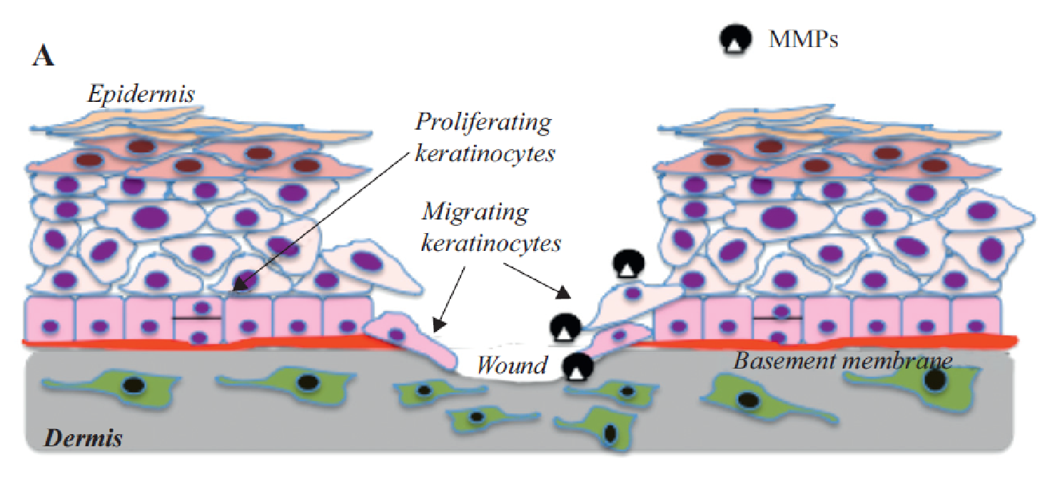
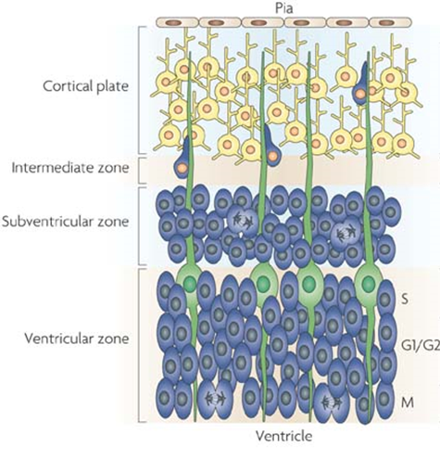
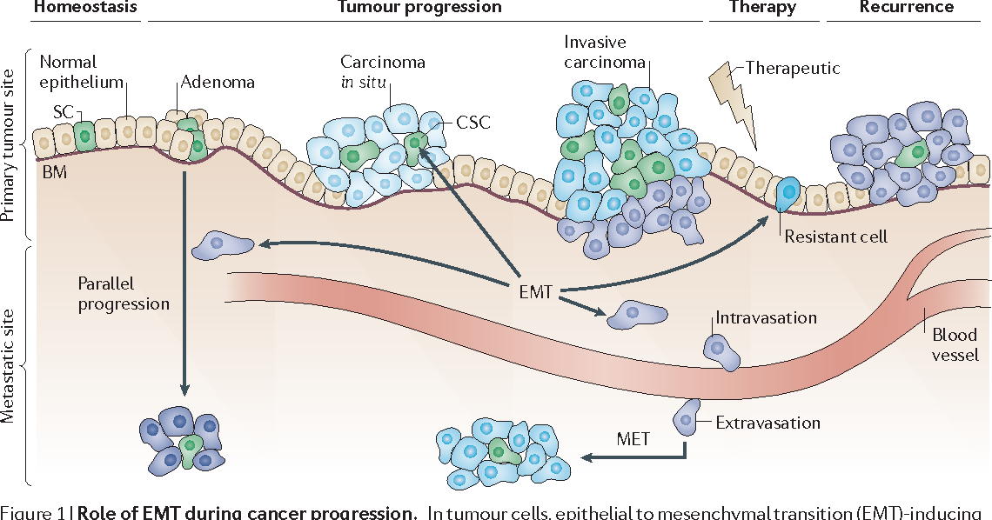
Motivation
Fig: Wound Repair
Fig: Brain Development[Herrup, K. et al., (2007). Nat Rev Neurosci 8(5)]
Fig: Cancer Invasion[Craene, B., Berx, G., Nature Reviews Cancer (2013)]

Slide 4
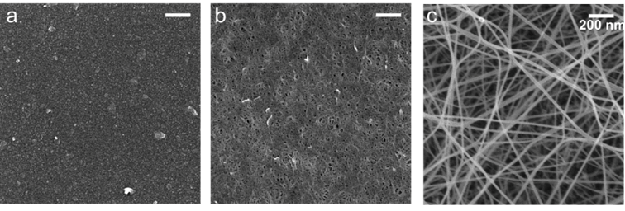
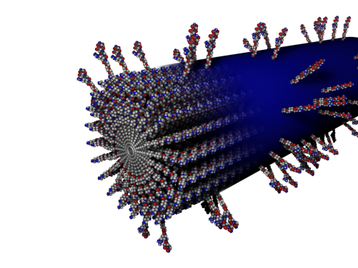
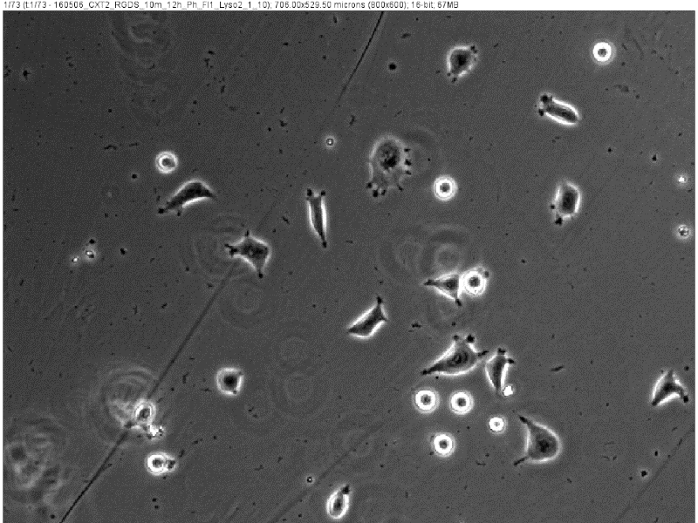
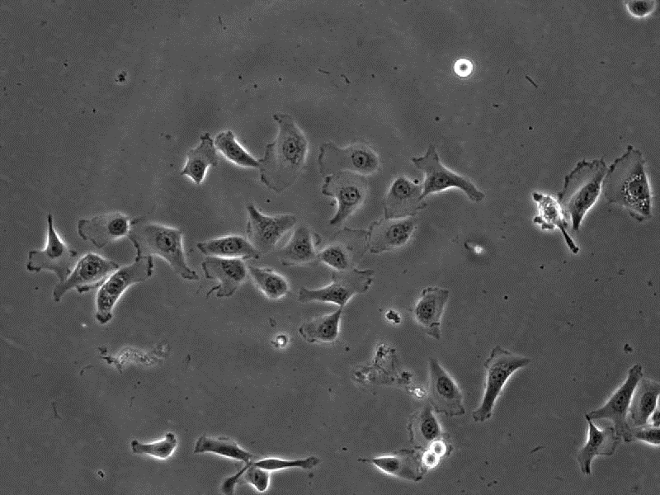
Dataset
Fig: PA(Peptide amphiphile) Coated Surface
Fig: PA with RGDS epitope
Fig: Glass Surface
Fig: Cell on Glass Surface
Fig: Cell on PA Coated Surface

Slide 5
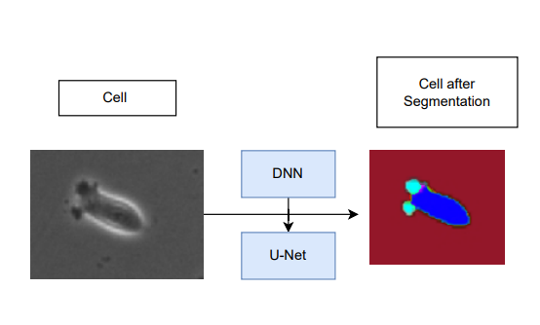
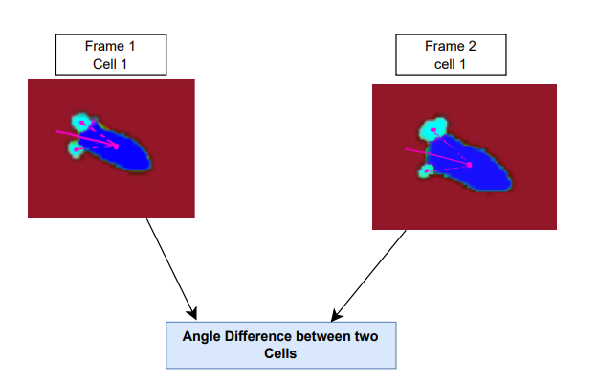
Methodology
Fig: Cell Segmentation
Fig: Cell Movement Tracking

Slide 6
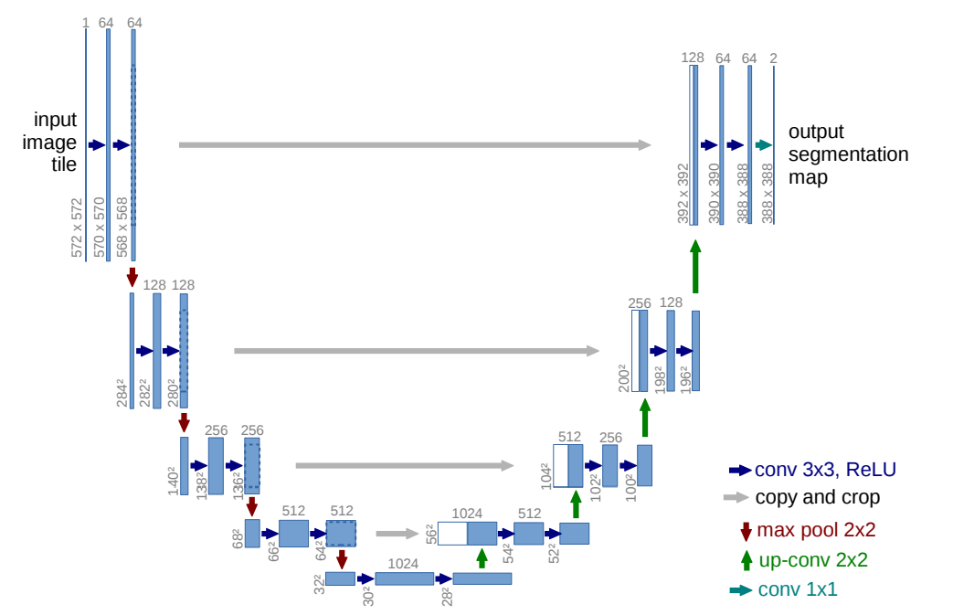
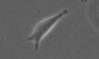

Methodology
Fig: U-Net architecture[https://arxiv.org/pdf/1505.04597.pdf]

Slide 7
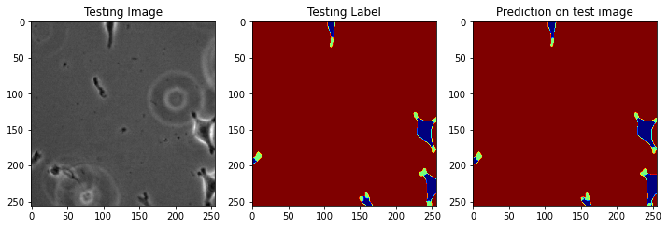
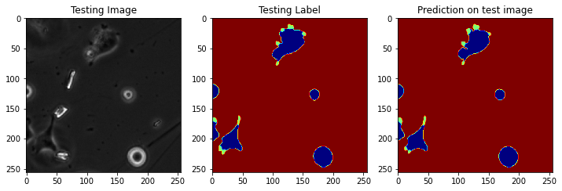
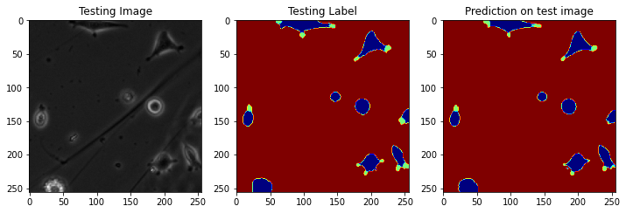
Segmentation Accuracy
Accuracy Matrix | Accuracy
IoU Accuracy Background accuracy Cell accuracy Denditric Process accuracy | 86.76% 99.33% 90.58% 70.37%
Fig: Result of Segmentation(Red is background, Blue is cell, Green is dendritic process)
Fig: Result of Segmentation(Red is background, Blue is cell, Green is dendritic process)
Fig: Result of Segmentation(Red is background, Blue is cell, Green is dendritic process)

Slide 8
Cell Movement Accuracy
We have tracked total forty frames for thirty cells. Here is the result of eight frames:

Slide 9
Cell Movement Accuracy

Slide 10
Discussion and Future Work
We have found on average 20-30 degree angle difference for all cases. So, we can conclude that there is a connection between cell movement and dendritic process.
The dynamics of dendritic process changes continuously. In future, we will look more into the dynamics and its importance on cell movement.
Thank you
Any Question?

